Slide 1
The Enemies of Gratitude:
Worry: Replacing Stress with Trust

Slide 2
What are the 10 Commandments? POP QUIZ

Slide 3
10 Commandments

Slide 4
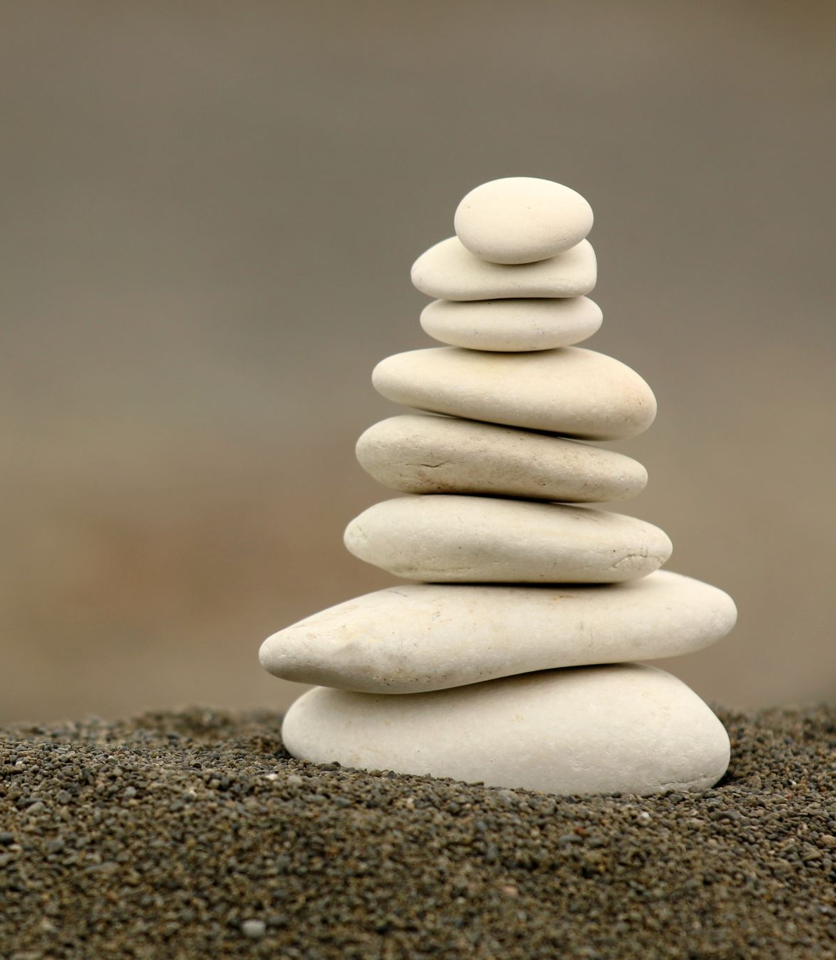
These commandments reveal a God who created us and knows where we can so easily go astray and get into trouble and loves us so much that we aren’t left without rules and structure for our life together.

Slide 5
Philippians 1:27-28
²⁷ Whatever happens, conduct yourselves in a manner worthy of the gospel of Christ. Then, whether I come and see you or only hear about you in my absence, I will know that you stand firm in the one Spirit,^{[e]} striving together as one for the faith of the gospel ²⁸ without being frightened in any way by those who oppose you.

Slide 6
Philippians 2:5-7
In your relationships with one another, have the same mindset as Christ Jesus:
Who, being in very nature^{[a]} God, did not consider equality with God something to be used to his own advantage;
rather, he made himself nothing by taking the very nature[b] of a servant, ^{being made in human likeness.}

Slide 7
“I urge Euodia, and I urge Syntyche to be of the same mind in the Lord.”
“I ask you … [to] help these women, for they have struggled beside me in the work of the gospel, together with Clement and the rest of my co-workers, whose names are in the book of life.”

Slide 8
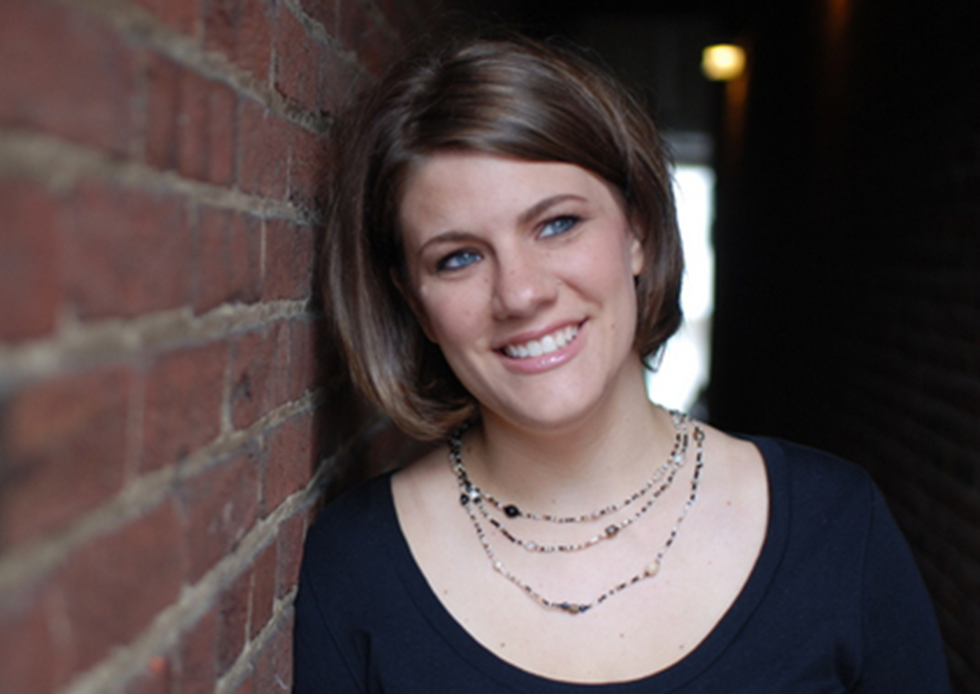
“The good news is you’re a beloved child of God; the bad news is you don’t get to choose your siblings.”
—Rachel Held Evans

Slide 9
Joy does not simply happen to us. We have to choose joy and keep choosing it every day. It is a choice based on the knowledge that we belong to God and have found in God our refuge and our safety and that nothing, not even death, can take God away from us. - Henri Nouwen

Slide 10
“Truth is not about a majority opinion, what’s trending in the news, or what gains traction on FB. It isn’t decided by humans or the “malls” of your life. The truth we have today is the same truth that exists when Jesus walked the earth. It is reliable, unchanging, and comforting. It is not a “thing,” but rather, a person: Jesus.” Kari Kampkis – “More Than A Mom”

Slide 11
John 14:6 (NLT)
Jesus answered, “I am the way, the truth, and the life. No one can come to the Father except through me.”

